Slide 1

Using Multiple Tables
Version 1.5

Slide 2
Overview
JOINs
Join types
UNION, EXCEPT and INTERSECT
Hands-on lab

Slide 3
OBJECTIVES
At the end of this module you will be able to:
write a query that joins two tables together
write a query that joins multiple tables
write a query that uses an OUTER JOIN
write a query that uses a UNION operator to join tables

Slide 4
JOINS

Slide 5
JOINs
SELECT <<field(s)>>
FROM <<table1>>
type-of JOIN <<table2>> ON <<predicate>>
WHERE <<condition(s)>>
GROUP BY <<field(s)>>
HAVING <<condition(s)>>
ORDER BY <<field(s)>>
Notes:
All of the queries we’ve written so far in this course have been against single tables.
In the wild, we very rarely actually want to run such queries, pulling in information from various tables in the database.
In fact, this is the whole point of Relational Database Theory, the idea of putting data into many different tables to improve the speed of updating and inserting data and also to reduce the amount of disk space used by databases. For querying, this data then needs to be pulled back together again.

Slide 6
Join types

Slide 7
Join types
JOINs
Join
(right, left, and full)
Notes:
There are two techniques for joining data together – JOINs, which will be the main focus of this chapter, and Set-based operations.
Within JOINs, there are three types: inner joins, outer joins and cross joins. Of the three, this course will only concern itself with the first two as cross joins are rarely, if ever, useful.
NB: The CROSS JOIN is used to generate a paired combination of each row of the first table with each row of the second table. This join type is also known as cartesian join.
Suppose that we are sitting in a coffee shop and we decide to order breakfast. Shortly, we will look at the menu and we will start thinking of which meal and drink combination could be more tastier. Our brain will receive this signal and begin to generate all meal and drink combinations.

Slide 8
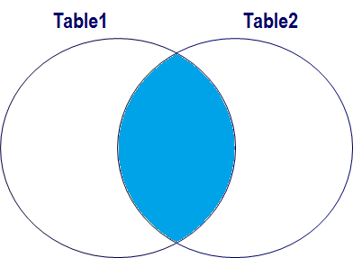
Inner join
Returns columns from both tables where the ON clause is true
SELECT *
FROM Table1 INNER JOIN Table2
ON Table1.Col1 = Table2.Col2
Notes:
Using two tables the INNER JOIN returns columns from both tables where the ON clause is satisfied. This is the most common type of join.
Used for joining tables previously split during the design phase into related tables, usually using a primary key – foreign key relationship.

Slide 9
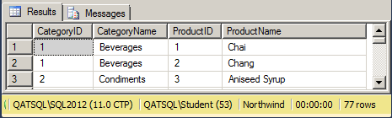
Inner join
SELECT Products.CategoryID, CategoryName, ProductID, ProductName FROM dbo.Products INNER JOIN dbo.Categories ON Products.CategoryID = Categories.CategoryID
SELECT p.CategoryID, CategoryName, ProductID, ProductName FROM dbo.Products AS p JOIN dbo.Categories AS c ON p.CategoryID = c.CategoryID
Notes:
When joining tables, we often use a column from one table (in this case the CategoryID column in the Products table) that has exactly the same name as a column in another table (in this case the CategoryID column in the Categories table). From the point of view of someone talking to the database, this makes perfect sense and actually makes the database’s structure easier to understand – clearly there is a relationship between products and categories and that relationship is defined via a CategoryID column. Unfortunately, computers are still nowhere near as clever as us humans and so SQL gets confused in both our select list and our ON predicate if there are columns with the same names in more than one table. So we need to qualify these “ambiguous” column names with the name of the table, which can become time-consuming.
This is where the ability to alias table names as well as column names starts to become useful – we can use a simple prefix to disambiguate the columns without making the query too much harder to read.
NOTE [1]: INNER JOIN is the default type of join, so we can leave out the INNER part in our queries.
NOTE [2]: It’s only the ambiguous column names that we must use the table name or alias for, but we often use it for every column, especially in queries that join more than two tables together, to make it easier to see at a glance which columns are coming from which tables. The query on the slide loses nothing and possibly gains readability, rewritten as:
SELECT p.CategoryID, c.CategoryName, p.ProductID, p.ProductName FROM dbo.Products AS p INNER JOIN dbo.Categories AS c
ON p.CategoryID = c.CategoryID

Slide 10
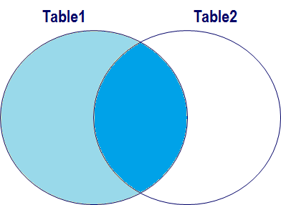
Left (outer) join
Returns columns from both tables where the ON clause is true and columns from Table1 in all cases
SELECT *
FROM Table1 LEFT JOIN Table2
ON Table1.Col1 = Table2.Col2
Notes:
Using two tables the LEFT JOIN returns columns from both tables where the ON clause is satisfied and also the columns from the first table where it is not satisfied.
Used for joining tables previously split during the design phase into related tables, usually using a primary key – foreign key relationship, and returning the mismatches as well.

Slide 11
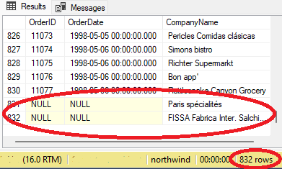
Left join
SELECT o.OrderID,
o.OrderDate,
c.CompanyName FROM dbo.Customers AS c –- Left Table LEFT JOIN dbo.Orders AS o
ON c.CustomerID = o.CustomerID
Notes:
In the example on the slide, we are running a query to get a list of all OrderIDs, their dates, and the companyname of the customers who placed the orders. If we had used an INNER JOIN, we would have got 830 rows back because there are 2 customers who have not placed any orders.
Instead, we use a LEFT JOIN to ask for all of the records in the Customers table, plus those records in the Orders table which have a match. Rows in the right-hand table without a match show up as nulls.
The First table after FROM will be the Left table(order here is important but not elsewhere in the query)
NOTE: Strictly speaking, a LEFT JOIN is a LEFT OUTER JOIN but the OUTER is implicit and therefore optional.
In a LEFT JOIN:
The left table is the one that comes before the "LEFT JOIN" phrase in the query
It returns all records from the left table and the matching records from the right table
If no match is found, NULL values are returned for right table's columns

Slide 12
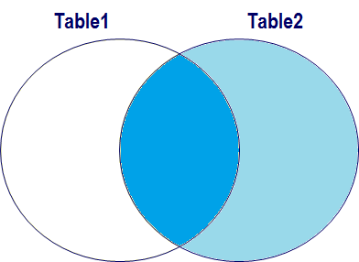
Right join
Returns columns from both tables where the ON clause is true and columns from Table2 in all cases
SELECT *
FROM Table1 RIGHT JOIN Table2
ON Table1.Col1 = Table2.Col2
Notes:
Using two tables the RIGHT JOIN returns columns from both tables where the ON clause is satisfied and also the columns from the second table where it is not satisfied.
Used for joining tables previously split during the design phase into related tables, usually using a primary key – foreign key relationship, and returning the mismatches as well.
If you’re thinking that looks a lot like the definition of a LEFT JOIN, you’re absolutely correct. The only difference between the two is which side of the JOIN keyword the table is. The one before the keyword is the left-hand table and the one after is the right-hand table. All LEFT JOINs can be rewritten as RIGHT JOINs and vice versa.
It’s usually just a matter of which table you start thinking about first.
A LEFT JOIN can have null values in columns from the right-hand table whereas a RIGHT JOIN can have null values in columns from the left-hand table.

Slide 13
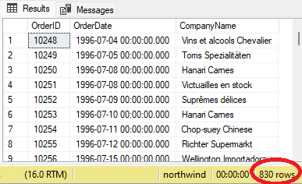
Right join
SELECT o.OrderID,
o.OrderDate,
c.CompanyName FROM dbo.Customers AS c RIGHT JOIN dbo.Orders AS o
ON c.CustomerID = o.CustomerID
Notes:
In the example on the slide, we have simply changed the LEFT keyword from the previous example into a RIGHT. The result set only contains 830 rows because we are asking for the rows in the Customers table that have corresponding entries in the Orders table, so any customers who have not placed orders will no longer exist.
To recreate the results of the previous example with the code above, either change the word RIGHT to read LEFT, or switch the order of the dbo.Customers and dbo.Orders tables in the FROM and JOIN clauses as follows:
SELECT o.OrderID,
o.OrderDate,
c.CompanyName FROM dbo.Orders AS o
RIGHT JOIN dbo.Customers AS c
ON c.CustomerID = o.CustomerID

Slide 14
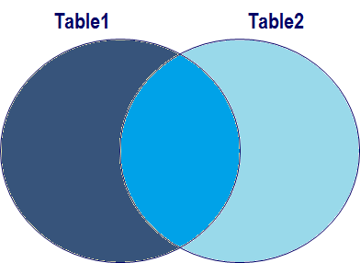
Full join
Returns columns from both tables where the ON clause is true and disjointed rows where matches are not found
SELECT *
FROM Table1 FULL JOIN Table2
ON Table1.Col1 = Table2.Col2
Notes:
Using two tables a FULL JOIN returns columns from both tables where the ON clause is satisfied, and also the columns from both tables separately where it is not satisfied
Commonly used for examining two versions of the same table to find mismatches.
So if a LEFT JOIN can have nulls in the right-hand table’s columns and a RIGHT JOIN can have nulls in the left-hand table’s columns then a FULL JOIN can have nulls on both sides.

Slide 15
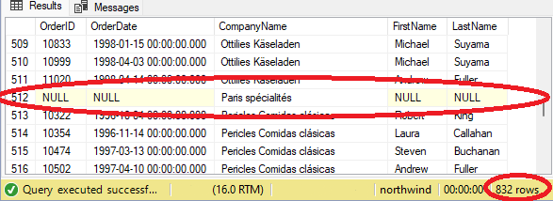
Joining more than two tables
SELECT
o.OrderID, o.OrderDate,
c.CompanyName, e.FirstName, e.LastName
FROM dbo.Customers AS c
LEFT JOIN dbo.Orders AS o
ON c.CustomerID = o.CustomerID
LEFT JOIN dbo.Employees AS e ON e.EmployeeID = o.EmployeeID
Notes:
We can of course join as many tables together as we like, as long as we have some way of telling SQL how to find the rows we’re interested in.
In the example on the slide, we’re completing the query on Customers and their Orders by adding another join to the earlier examples. We are in effect joining the Employees table to the combined Customers & Orders result set, so we need to use a LEFT JOIN to make sure we see all 832 rows, plus any employees we can find. Obviously, any rows that have a null for OrderID and OrderDate from the Orders table are going to have nulls for employee names.

Slide 16
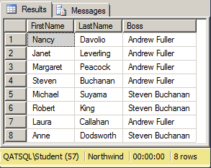
Joining a table to itself
SELECT emp.FirstName, emp.LastName, mgr.FirstName + ' ' + mgr.LastName AS Boss FROM dbo.Employees AS emp JOIN dbo.Employees AS mgr ON emp.ReportsTo = mgr.EmployeeID
Notes:
Some tables can contain columns that refer back to the same table. A classic example is in the Northwind database’s Employees table, where there is a ReportsTo column which contains the EmployeeID of the employee’s manager.
If we want to write a query that lists employees and their managers, we will need to join that table to itself. In these circumstances, we will have to use aliases for the table names to avoid ambiguity.
In the example on the slide, a keen observer might notice that there is an employee missing.

Slide 17
UNION, EXCEPT, and INTERSECT

Slide 18
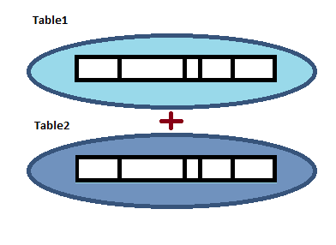
Union [All]
Accumulation of both sets
Duplicates may occur with ALL
SELECT * FROM Table1
UNION
SELECT * FROM Table2
Notes:
Using two tables a UNION returns rows from both tables. If duplicates exist in the two tables they are removed unless we specify UNION ALL. Columns in both select lists must match in quantity and data type (or the data types must be convertible by SQL)
The difference between JOIN and UNION in SQL lies in their fundamental purposes and the way they merge data. JOIN is used to combine rows from two or more tables based on a related column, while UNION is used to combine the results of two or more SELECT statements into a single result set.
The query below returns the ProductID of all products that have either total sales order quantity greater than 500 or a list price greater than 150.
SELECT ProductID
FROM dbo.[Order Details]
GROUP BY ProductID
HAVING SUM(Quantity) > 700
UNION
SELECT ProductID
FROM dbo.Products
WHERE UnitPrice > 100
This query should return 39 rows in ProductID order. With a UNION ALL instead, it will return 40 rows in no particular order.
Within this group of operations, excepts and intersects are more often written using WHERE clauses while unions can be very useful.
The SQL JOIN is used when we have to extract data from more than one table. The SQL UNION is used when we have to display the results of two or more SELECT statements. In the case of SQL JOINS, the records are combined into new columns. In the case of SQL UNION, the records are combined into new rows.

Slide 19
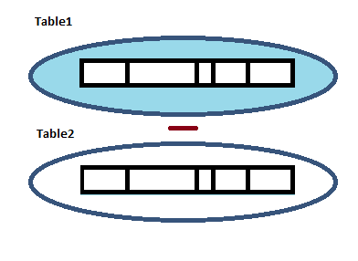
Except
Rows from Table1 where they do not exist in Table2
SELECT * FROM Table1
EXCEPT
SELECT * FROM Table2
Notes:
Using two tables the EXCEPT returns rows that exist in the first table but not in the second. As with a UNION, columns in the select list must match in quantity and data type. It is something like a set-based subtraction.
The query below returns the ProductID of all products that with a list price greater than 100 that have not sold more than 700 units:
SELECT ProductID
FROM dbo.Products
WHERE UnitPrice > 100
EXCEPT
SELECT ProductID
FROM dbo.[Order Details]
GROUP BY ProductID
HAVING SUM(Quantity) > 700
This query should return 1 row – ProductID 38. It could be rewritten using joins, which would also enable us to get more columns back in the results:
SELECT p.ProductID, p.UnitPrice, SUM(Quantity) AS TotalSold
FROM dbo.Products AS p
JOIN dbo.[Order Details] AS od
ON p.ProductID = od.ProductID
WHERE p.UnitPrice > 100
GROUP BY p.ProductID, p.UnitPrice
HAVING SUM(Quantity) <= 700

Slide 20
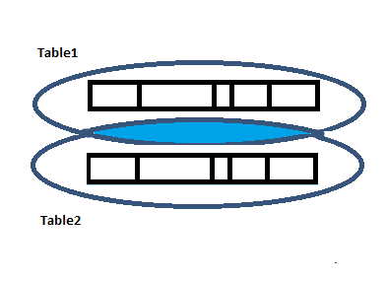
Intersect
Rows that exist in both sets will be returned
SELECT * FROM Table1
INTERSECT
SELECT * FROM Table2
Notes:
Using two tables the INTERSECT returns rows that exist in both tables. Columns in the select list must match in quantity and data type.
The query below returns the ProductID of all products that with a list price greater than 100 that have sold more than 700 units:
SELECT ProductID
FROM dbo.Products
WHERE UnitPrice > 100
INTERSECT
SELECT ProductID
FROM dbo.[Order Details]
GROUP BY ProductID
HAVING SUM(Quantity) > 700
select ProductName, UnitPrice from Products
Where ProductID = 29
This query should return 1 row – ProductID 29. It could be rewritten using joins, which would also enable us to get more columns back in the results:
SELECT p.ProductID, p.UnitPrice, SUM(Quantity) AS TotalSold
FROM dbo.Products AS p
JOIN dbo.[Order Details] AS od
ON p.ProductID = od.ProductID
WHERE p.UnitPrice > 100
GROUP BY p.ProductID, p.UnitPrice
HAVING SUM(Quantity) > 700
INNER JOIN blends data from multiple tables, creating one comprehensive result. In contrast, INTERSECT focuses on common rows between SELECT statements. INNER JOIN relies on a shared column or field to connect tables, while INTERSECT works based on the structure of SELECT statements

Slide 21
Hands-on lab
Inner joins
Outer joins
Unions

Slide 22
Review
JOINs
Join types
UNION, EXCEPT, and INTERSECT

